Slide 1
Machine Learning 1 Final Term Project
Traffic Sign detection Using convolutional neural network(CNN)
Group 5: Atharva Haldankar

Slide 2
Scope of Project
Using German Traffic Sign Recognition Benchmark dataset to train the CNN model to predict meaning of any road sign with the help of TensorFlow and Keras.
This model can be used by modern cars which drives itself, to keep the laws in check while the car drives itself.

Slide 3
About the data
The data was obtained from GTRSB Kaggle competition.
There are over 35,000 images with which the model is trained with 43 classes.
Each class represents a different traffic signs.

Slide 4
Reading the data
The for loop goes through the 43 folders in the training data and reads all the images in each folder with the folder names as their respective classes.
The training images are read with the help of opencv (cv2.imread).
It stores the images as a numpy.array in BGR format.
These images are stored as “images” in the program.
The 43 classes representing the traffic signs are stored as ”classNo” and are integers.

Slide 5
Splitting the data
The data is split as follows:
Train set : 80% of the data
Train set is further divided into training and validation as 80% and 20% respectively.
Test set : 20% of the data.

Slide 6
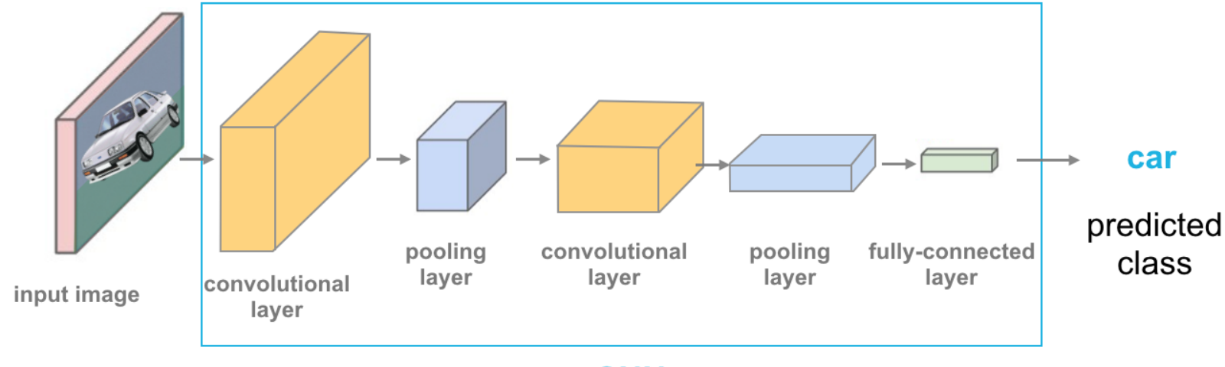
Architecture of the model
Using CNN (4 layers)
Using pooling layer which uses max as the activation function
Using SoftMax as the activation function for the output layer.

Slide 7
Training the model
Training with frozen pretrained layers.
7 iterations
Learning rate = 0.001
Batch size = 400
Steps per iteration = len(X_train)//50
Accuracy = 0.83

Slide 8
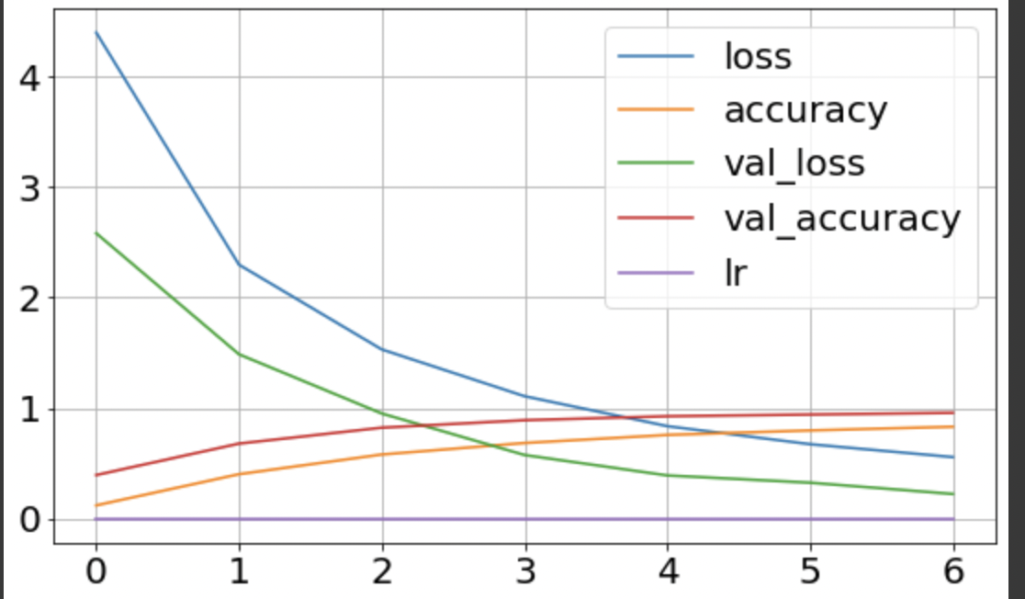
Learning curve for training with unfrozen pretrained layers

Slide 9
Testing the model
The best model was trained and saved for future use.
After testing the model the following was achieved:
Accuracy = 0.95
Loss = 0.214

Slide 10
Conclusion
The results obtained from testing the models are very good and they indicate that model is 96.63% accurate.
When a sample image is fit, the probability of predicting the right road sign is very high.
This model can successfully be implemented in automated cars to follow traffic rules.

Slide 11
Thank You!
Kaggle link:https://www.kaggle.com/datasets/meowmeowmeowmeowmeow/gtsrb-german-traffic-sign

